Slide 1
Evolution

Slide 2



Mvc
THANKS TO JEREMY LIKNESS
FOR THE PICTURES!

Slide 3

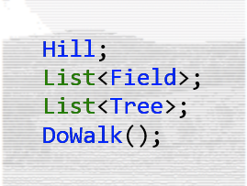
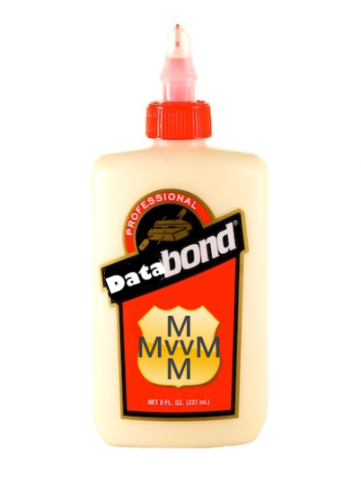
Mvvm

Slide 4



Mvx

Slide 5
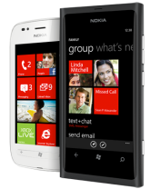
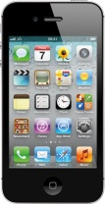

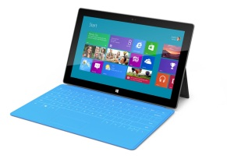
MvvmCross
MVVMCROSS
DataBinding, IoC, Plugins, Trace, INPC, Collections, Helpers, …
Xamarin.iOS
Xamarin.Android
Core
Portable Class Library
Windows 8
WindowsPhone 8
WPF

Slide 6
The DNA Trail so far…
v1
v2
v3
ViewModel++
Binding++
Async++
Patterns++
AutoViews…
TVs? Glasses?
INPC
DataBinding
.iOS
.Android
.WP
PCLs
Plugins
.WinStore
.Wpf
‘Clean’
CoreCross
.Mac
Nov ’11
to
Mar ‘12
Apr ’12
to
Oct ‘12
Nov ’12
to
Jun ‘13

Slide 7
Mvvm Mechanics

Slide 8
View
ViewModel
Model
View
ViewModel
Model
View
ViewModel
Model
get/set Properties
call Commands
Whatever C# you like …
… messages work well!
notify changes
some messaging
Platform Specific
Cross Platform

Slide 9
Data Binding

Slide 10
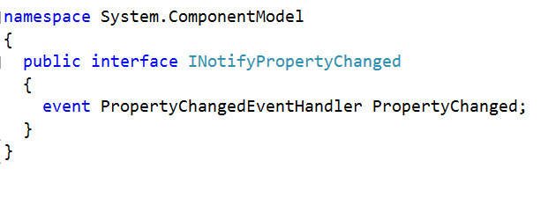
INotifyPropertyChanged

Slide 11
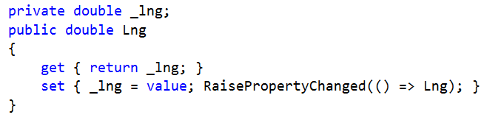
Typical ViewModel Property

Slide 12
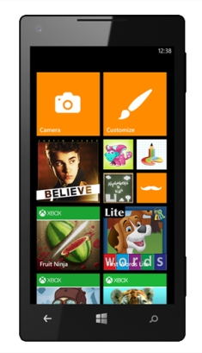
One Way Binding
PersonViewModel
First Name
Jon
Last Name
Doe
Date of birth
12/07/1989
FirstName
LastName
DateOfBirth

Slide 13

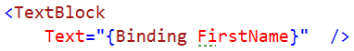

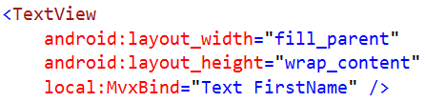

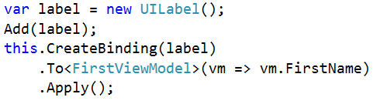
UI Syntax

Slide 14
Two Way Binding
PersonViewModel
First Name
Jon
Last Name
Doe
Date of birth
12/07/1989
FirstName
LastName
DateOfBirth

Slide 15
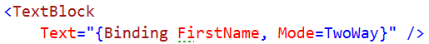
UI Syntax

Slide 16
Value Conversion
PersonViewModel
First Name
Jon
Last Name
Doe
Age
24
FirstName
LastName
DateOfBirth
“Age” Conversion

Slide 17
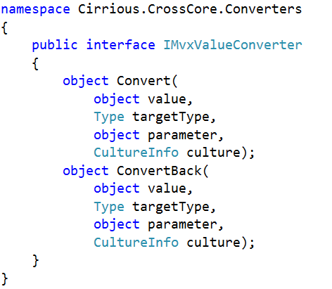
IMvxValueConverter

Slide 18
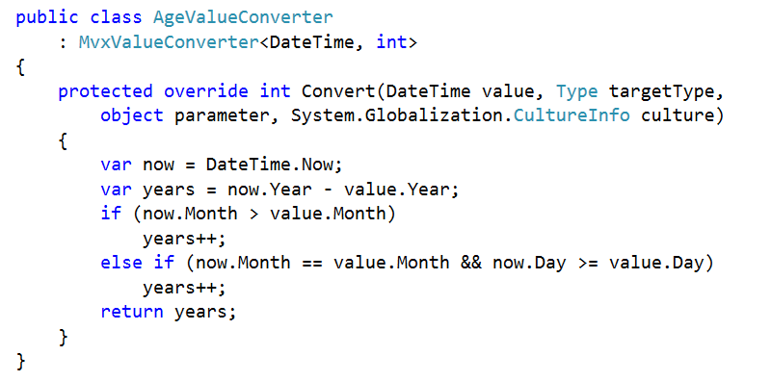
AgeValueConverter

Slide 19
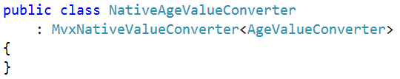
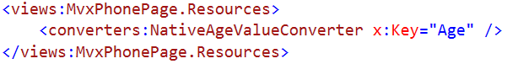
UI Syntax

Slide 20
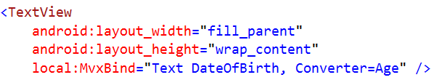
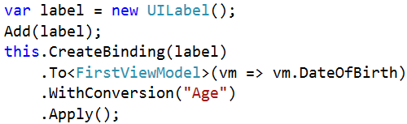
UI Syntax

Slide 21

Binding Actions
PersonViewModel
First Name
Jon
Last Name
Doe
Date of birth
12/07/1989
FirstName
LastName
DateOfBirth
AddCommand

Slide 22
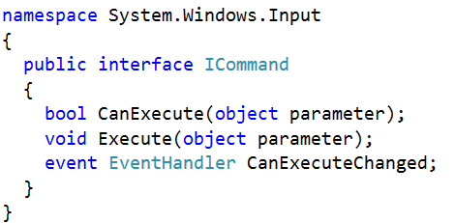
ICommand

Slide 23
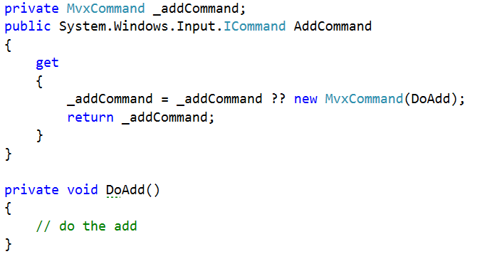
Typical ViewModel Command

Slide 24
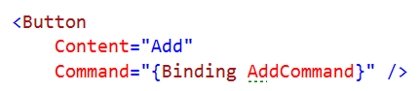
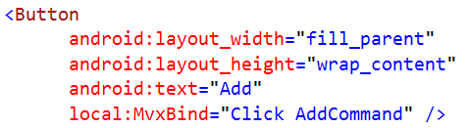
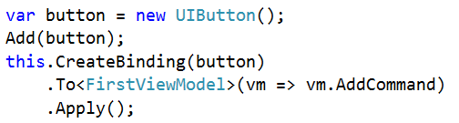
UI Syntax

Slide 25





Collections
PeopleViewModel
Cool Hackers
Greg
@gshackles
Hackers
List<PersonViewModel>
Jon
@redth
Greg
Daniel
@dsplaisted
Jon
Tomasz
@cheesebar
Daniel
Tomasz

Slide 26
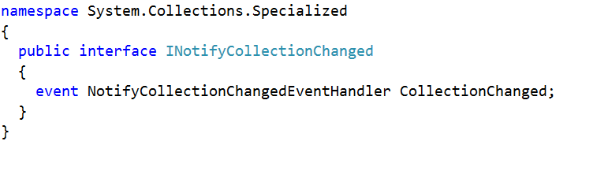
INotifyCollectionChanged

Slide 27
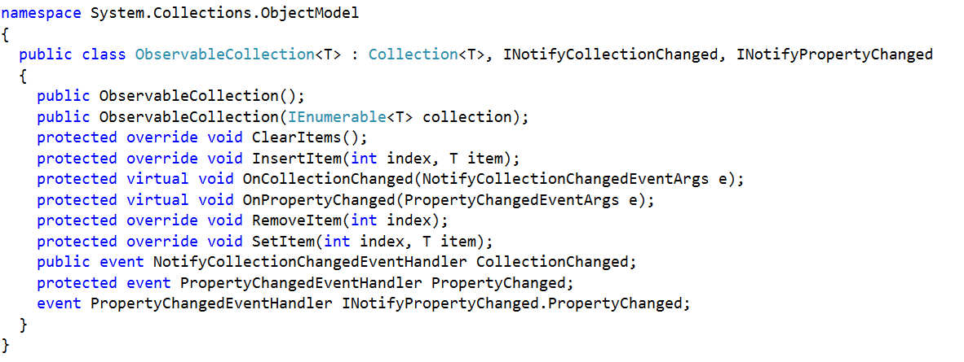
ObservableCollection

Slide 28
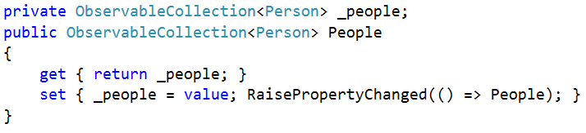
ViewModel Collection Property

Slide 29
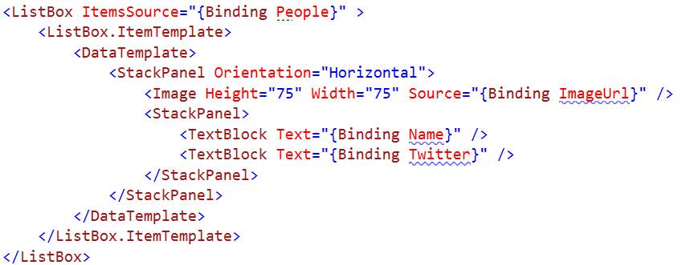
UI Syntax

Slide 30
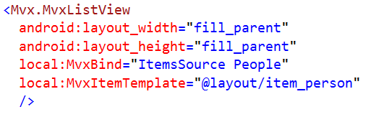
UI Syntax

Slide 31
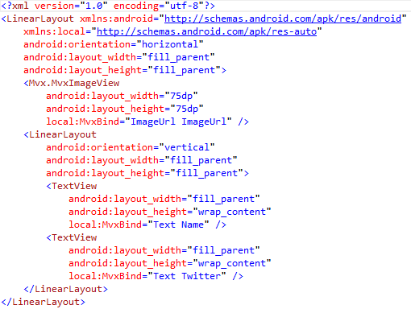
UI Syntax

Slide 32
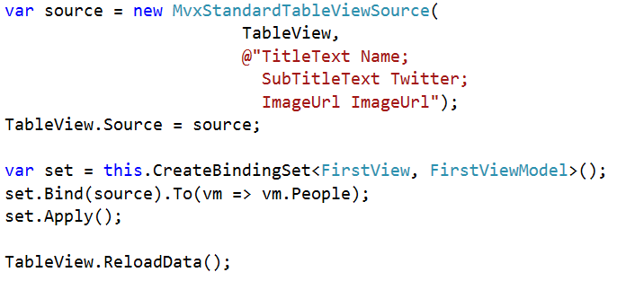
UI Syntax

Slide 33
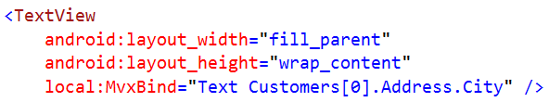
Data-Binding to Sub-Objects
Works using normal . and [] chaining:
obeys INotifyPropertyChanged at every step

Slide 34
Messenger

Slide 35
Messenger
Publisher
Subscribers
Message
Subscriber
Subscribers

Slide 36
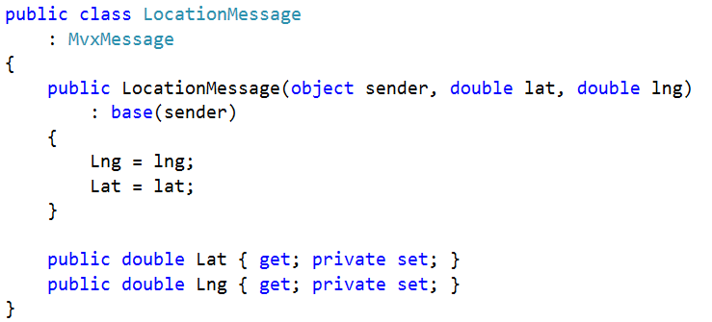
Message

Slide 37
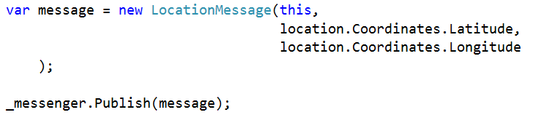
Publish

Slide 38
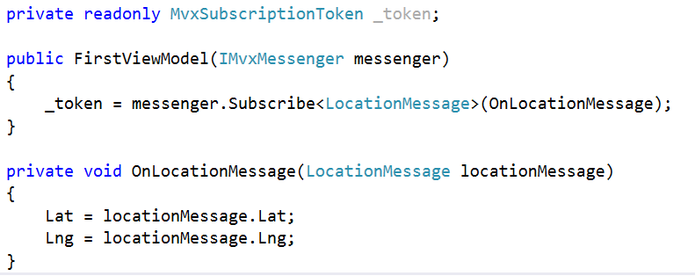
Subscribe

Slide 39
Interface Driven Development

Slide 40

Inversion of Construction (Inversion of Control)
Windows Phone SQL
Needs SQL
MyViewModel
My Tax Calculator
Needs Calculator
Windows Phone Location
Needs Location
The Container

Slide 41
Inversion of Construction (Inversion of Control)
iOS SQL
Needs SQL
MyViewModel
My Tax Calculator
Needs Calculator
iOS Location
Needs Location
The Container

Slide 42
Mvx.Register<T>
The Container
(Mvx)

Slide 43
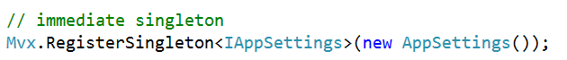
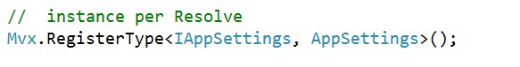
Mvx.Register<T>
RegisterSingleton
Lazy - RegisterSingleton
RegisterType

Slide 44
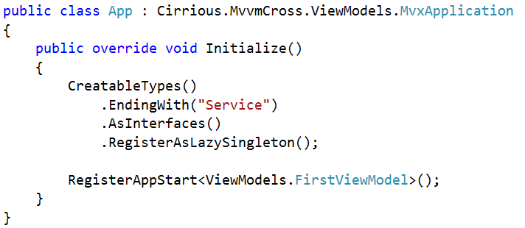
Automatic Registration

Slide 45
Mvx.Resolve<T>

Slide 46
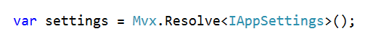
Mvx.Resolve<T>
Resolve
CanResolve
TryResolve

Slide 47
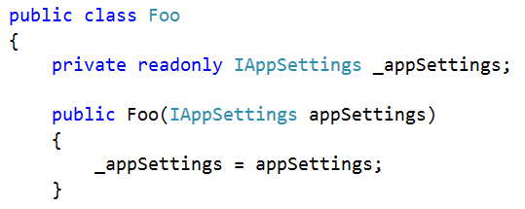
Mvx Construction
Constructor resolution
IoCConstruct

Slide 48
Portable Class Libraries

Slide 49
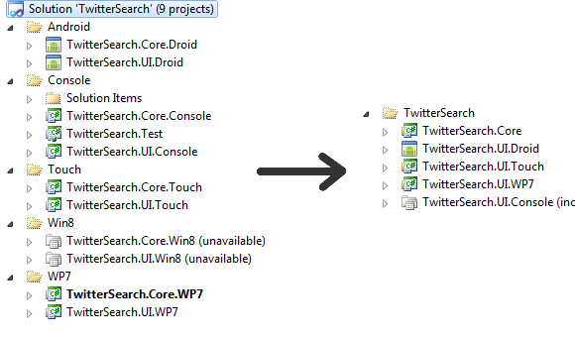

Slide 50
My
.Portable
MvvmCross
.Portable
Plugin1
.Portable
Plugin2
.Portable
…
My
.WP7
My
.Touch
My
.Droid
My
.WinRT
MvvmCross
.Wp7
MvvmCross
.Touch
MvvmCross
.Droid
MvvmCross
.WinRT
Plugin1
.Wp7
Plugin1
.Touch
Plugin1
.Droid
Plugin1
.WinRT
Plugin2
.Wp7
Plugin2
.Touch
Plugin2
.Droid
Plugin2
.WinRT
…
…
…
…

Slide 51
Profile 104
WPF – 4.5+
Windows Store (WinRT)
Windows Phone – 7.1+
Xamarin.Android*
Xamarin.iOS*
async/await via BCL Async NuGet Package… (if you like pain)

Slide 52
Profile 78
WPF – 4.5+
Windows Store (WinRT)
Windows Phone – 8+
Xamarin.Android**
Xamarin.iOS**
async/await “just works”

Slide 53
Presenters

Slide 54
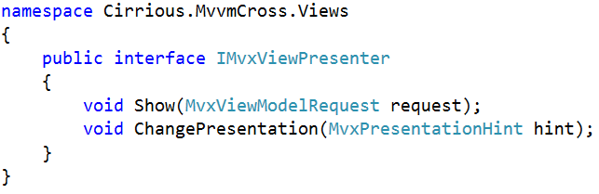
IMvxViewPresenter

Slide 55
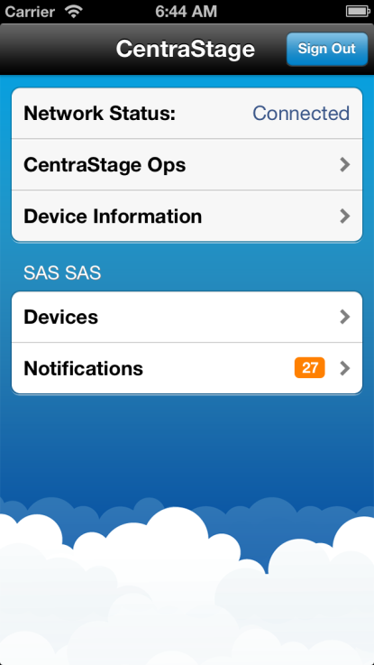
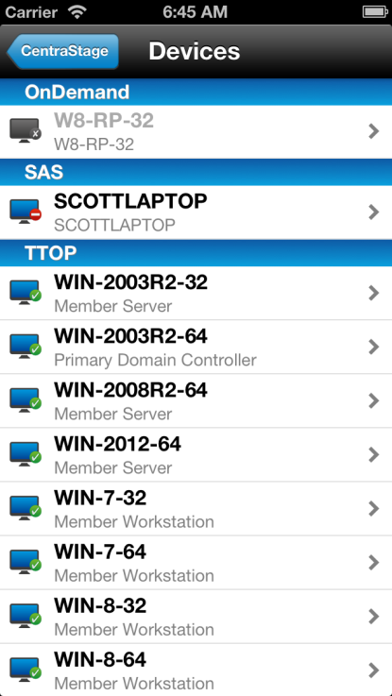
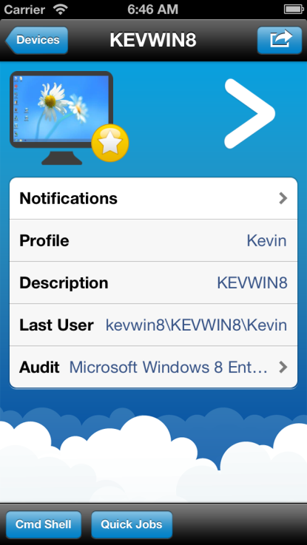
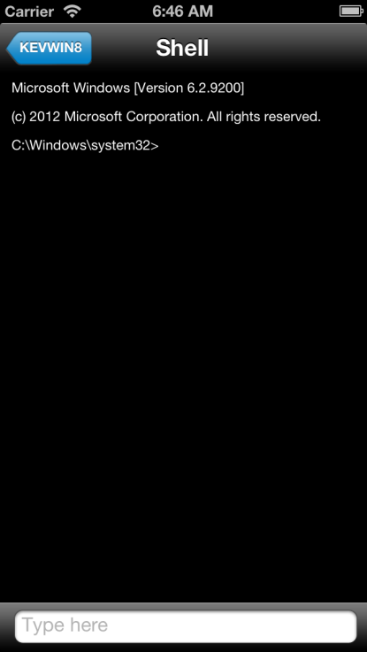
Page by Page

Slide 56
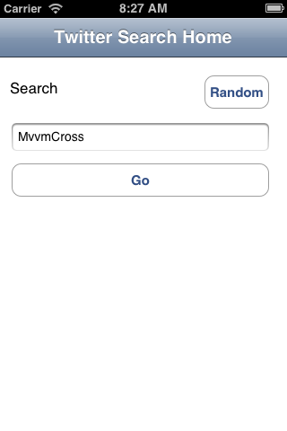
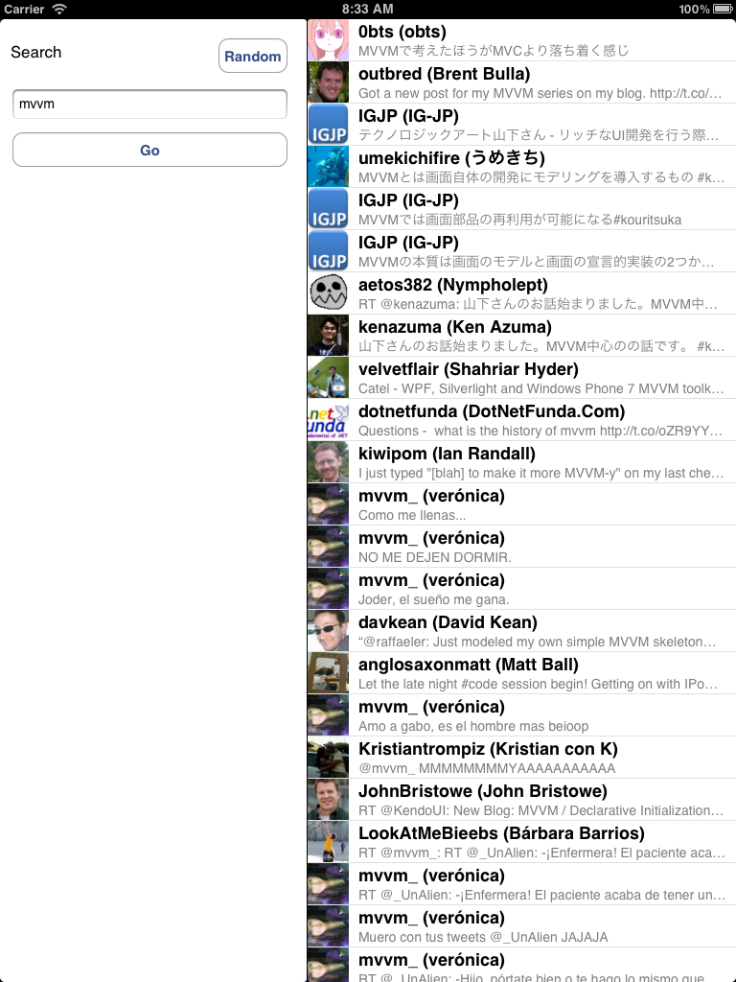

Split View

Slide 57
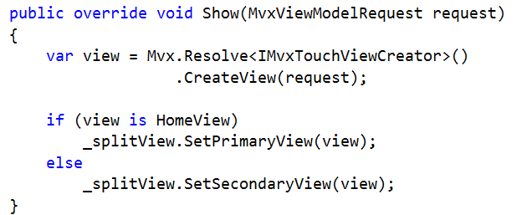
SplitViewPresenter example

Slide 58
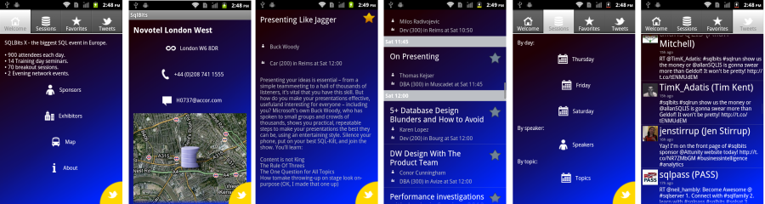
Tabs and Panoramas

Slide 59
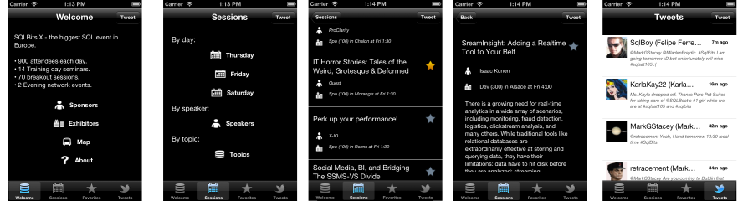
Tabs and Panoramas

Slide 60

Tabs and Panoramas

Slide 61
Fragments (Android UserControls)

Slide 62
App Start

Slide 63

IMvxAppStart

Slide 64

Simple Starts

Slide 65

Conditional Starts

Slide 66

Protocol Starts (Deep Links)
Parse the protocol hint… e.g.

Slide 67

Protocol Starts (Deep Links)
Use the parsed protocol hint:

Slide 68
Writing Plugins

Slide 69
What is a plugin?
Plugins are just a layer on top of IoC
Each Plugin has:
A Portable Core
Includes the interface definition
Has PluginLoader.Instance entry point
(optional) Platform extensions
Extensions identified by naming conventions
Each has a Plugin entry point

Slide 70
A Vibrate plugin
Core:

Slide 71
A Vibrate plugin
e.g. iOS Adaption:

Slide 72
A Vibrate plugin
e.g. WP Adaption:

Slide 73
A Vibrate plugin
Finished Source Tree:

Slide 74
Custom Controls

Slide 75
Todo…

Slide 76
Custom Bindings

Slide 77
Todo…

Slide 78
Cross Light

Slide 79
Todo…

Slide 80
Customising Startup

Slide 81
Todo…

Slide 82
Async

Slide 83
Todo…

Slide 84
Testing

Slide 85
Todo…

Slide 86





























Superhero Break…

Slide 87
How much does Shared Code matter?
Savings are less where your code:
Is very platform specific
In very small apps
Spends much of its time in very tight integration with platform lifecycles
Won’t be reused/maintained much

